Slide 1

Applied Machine Learning
Manuel Arambula, Quoc Dat Cao, Xavier Maravilla, Levi Valencia

Slide 2


Introduction
Goal: Evaluate supervised ML model on 3 datasets.
Tackled real-world challenges like imbalance datasets.
Preprocessing: Standardization, outlier removal, polynomial features, hyperparameter tuning.
Models: Logistic Regression, K-NN, Naïve Bayes, Decision Tree, Random Forest.

Slide 3
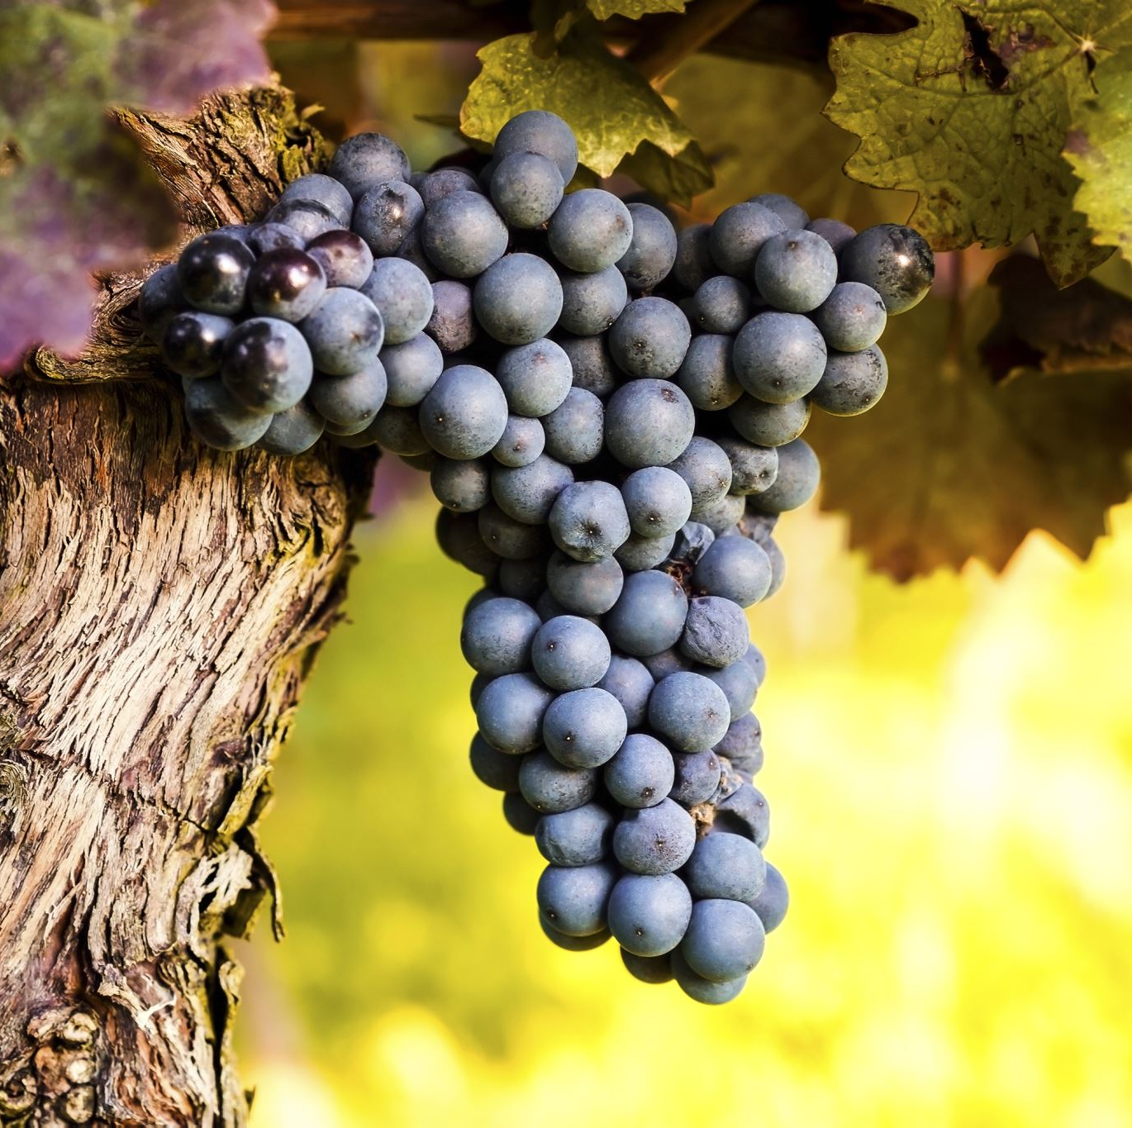
2. Related Works
Wine Dataset:
Cortez et al. (2009) predicted wine quality with SVM (62.4% and 64.6% accuracy).
Car Dataset:
Bohanec and Rajkovic (1988) used decision-making systems based on tree-structured criteria.

Slide 4
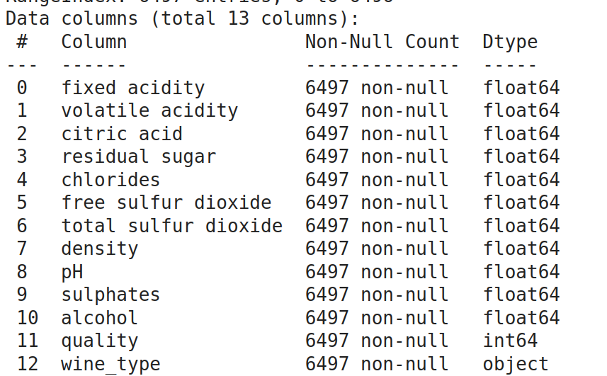
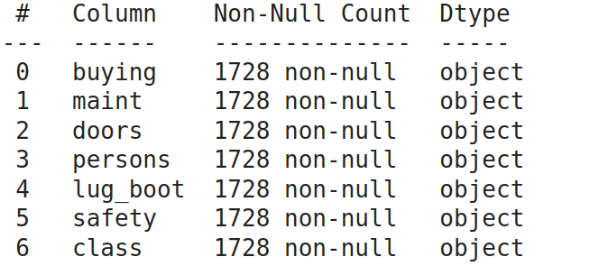
3. Datasets Overview
Wine Datasets:
Red wine (1599 samples), White wine (4898 samples).
11 features + quality label (0–10).
Imbalanced (most samples quality 5–7).
Car Evaluation Dataset:
6 categorical features, 1728 samples.
Hierarchical decision model.

Slide 5
4. Preprocessing Steps
Wine Dataset
Standardization: Rescaled features to mean=0, std=1.
Polynomial Feature Transformation: Degree 3, to capture non-linear patterns.
Z-score Outlier Removal: Threshold=3; removed extreme outliers to stabilize models.
80/20 Train-Test Split: Ensured balanced evaluation and enough training data.
Car Dataset
Label Encoding: Converted categorical features into numbers.
Standardization: Even categorical values were scaled for distance-based models like K-NN.
Polynomial Features: Degree 3 added complexity
Z-score Filtering: Minor improvements; categorical data had fewer outliers.
GridSearchCV: Hyperparameter tuning for best model settings

Slide 6

5. Methodology – Models Used
Logistic Regression
Strong baseline for multi-class classification.
Simple, interpretable model — good for numeric features.
Performed better after standardization and polynomial transformation.
K-Nearest Neighbors (K-NN)
Simple, non-parametric model.
Great for non-linear decision boundaries.
Very sensitive to feature scaling — benefitted heavily from standardization and tuning.
Random Forest Classifier
Ensemble of Decision Trees; reduces overfitting.
Automatically handles feature interactions and outliers.
Most robust model for the Wine dataset, high accuracy without needing heavy preprocessing.
Wine Dataset Models

Slide 7

5. Methodology – Models Used (Cont. )
K-Nearest Neighbors (K-NN)
Same K-NN model; relied on distance between points.
Needed careful scaling for encoded categorical features.
Decision Tree Classifier
Naturally fits structured, categorical data.
Fast to train, easy to interpret.
Achieved near-perfect classification on Car dataset.
Categorical Naive Bayes
Probabilistic model tailored for categorical features.
Lightweight, fast, but assumes feature independence — limited improvement from feature engineering.
Car Dataset Models

Slide 8
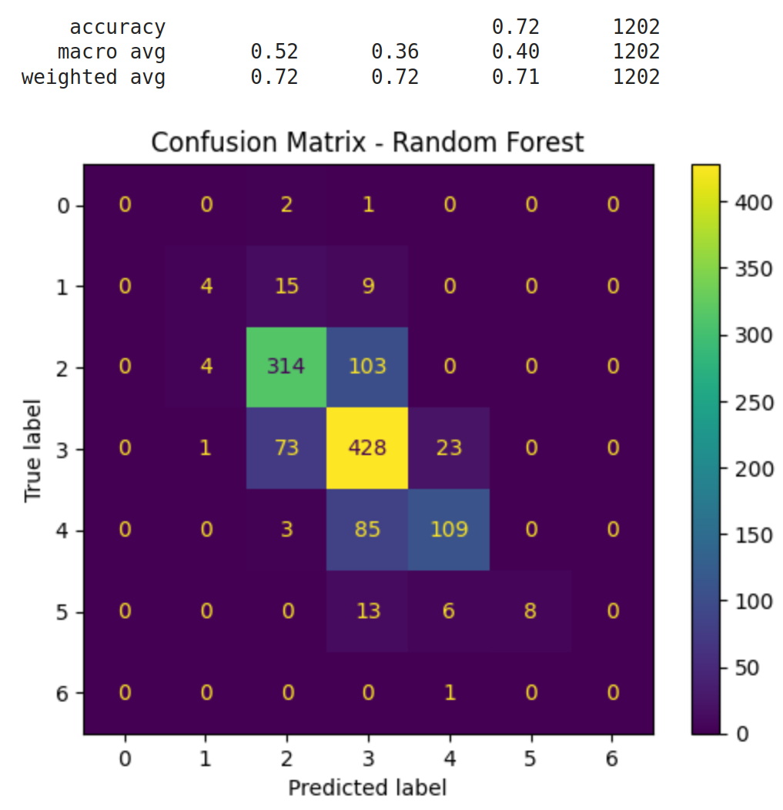
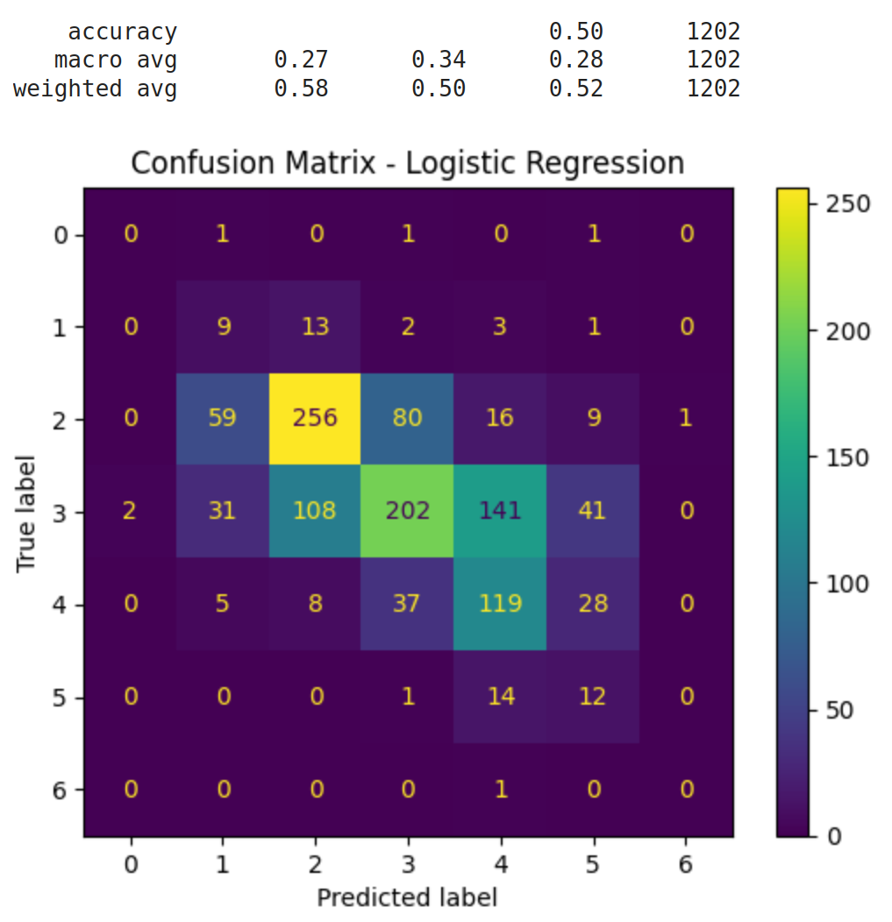
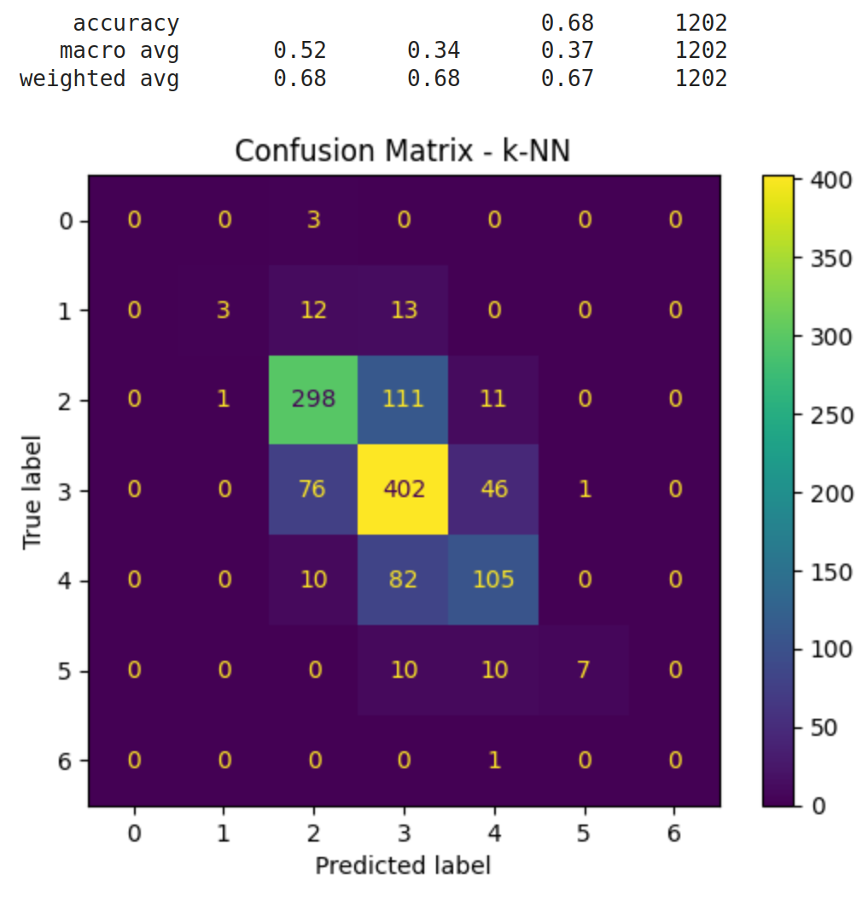
6. Results - Wine Dataset
Logistic Regression: 50% accuracy (up from 32% with polynomial features).
K-NN: Improved to 68% with outlier removal and tuning (n=5, Manhattan distance).
Random Forest: Best performance (72% accuracy).Naturally handled outliers and feature interactions.

Slide 9
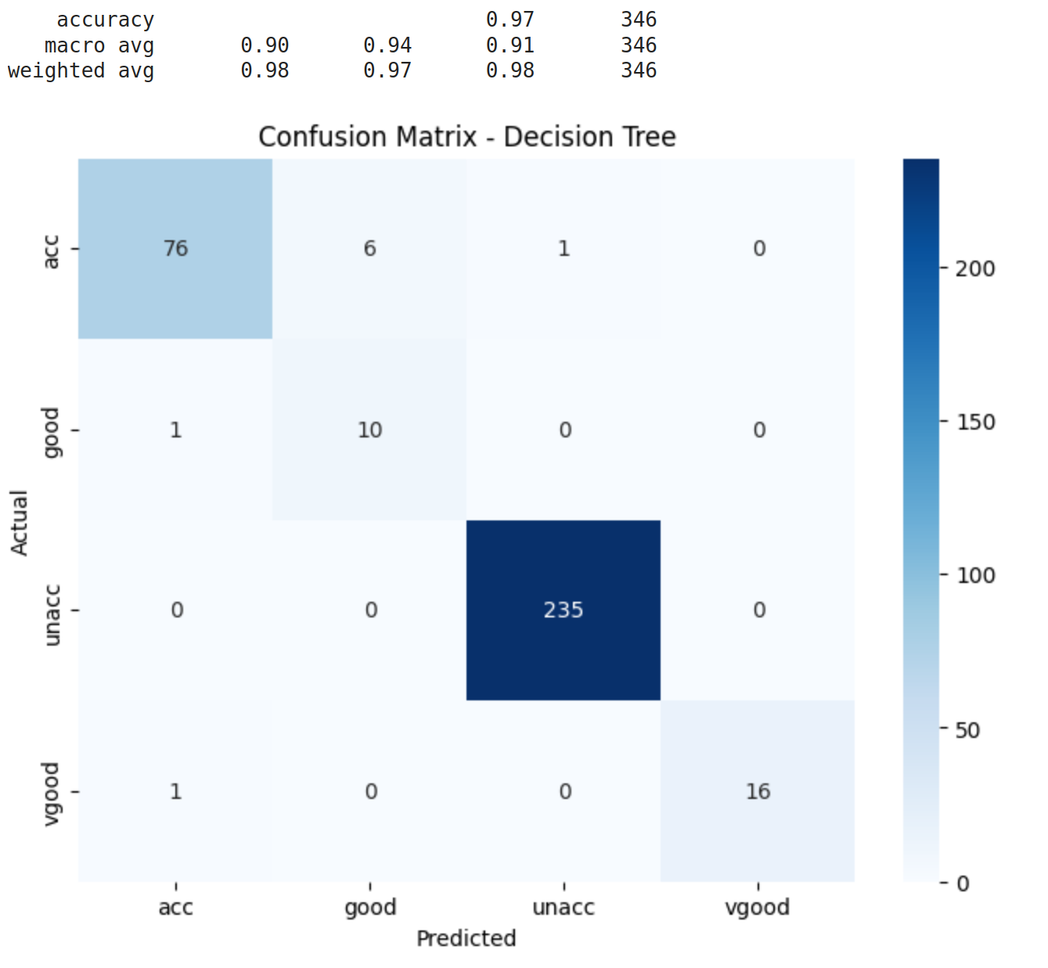
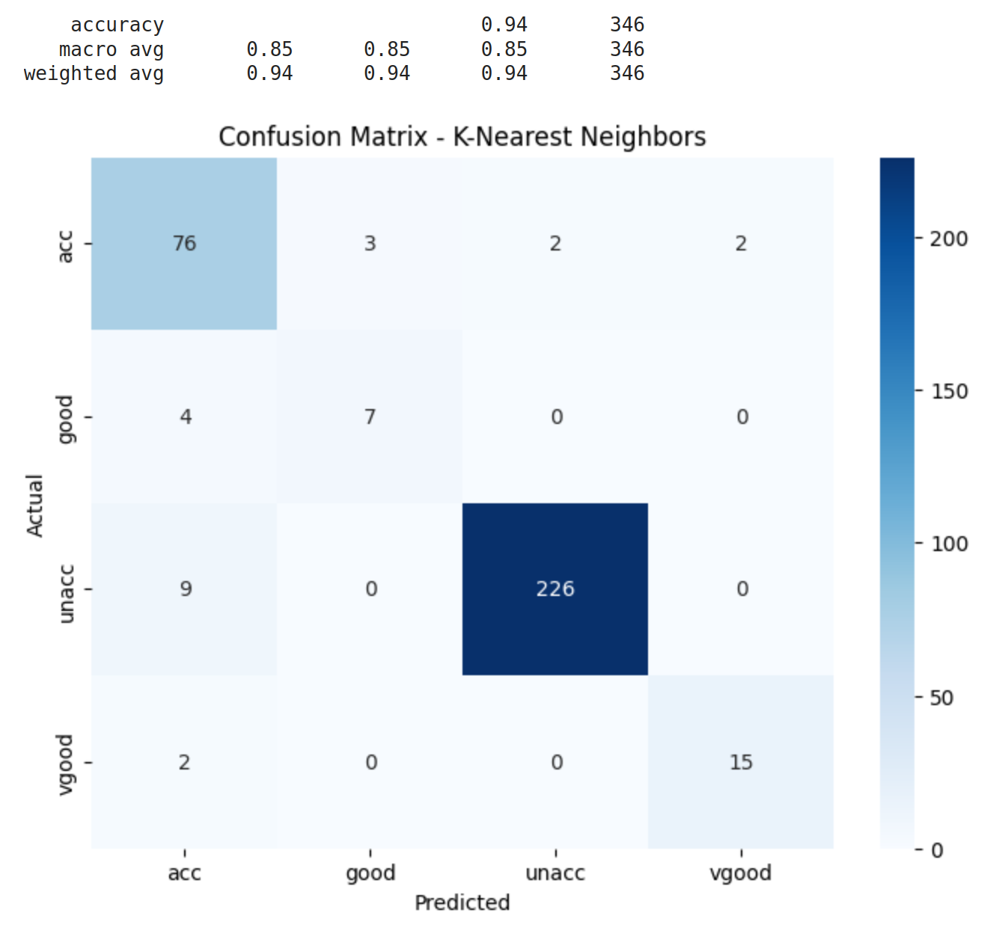
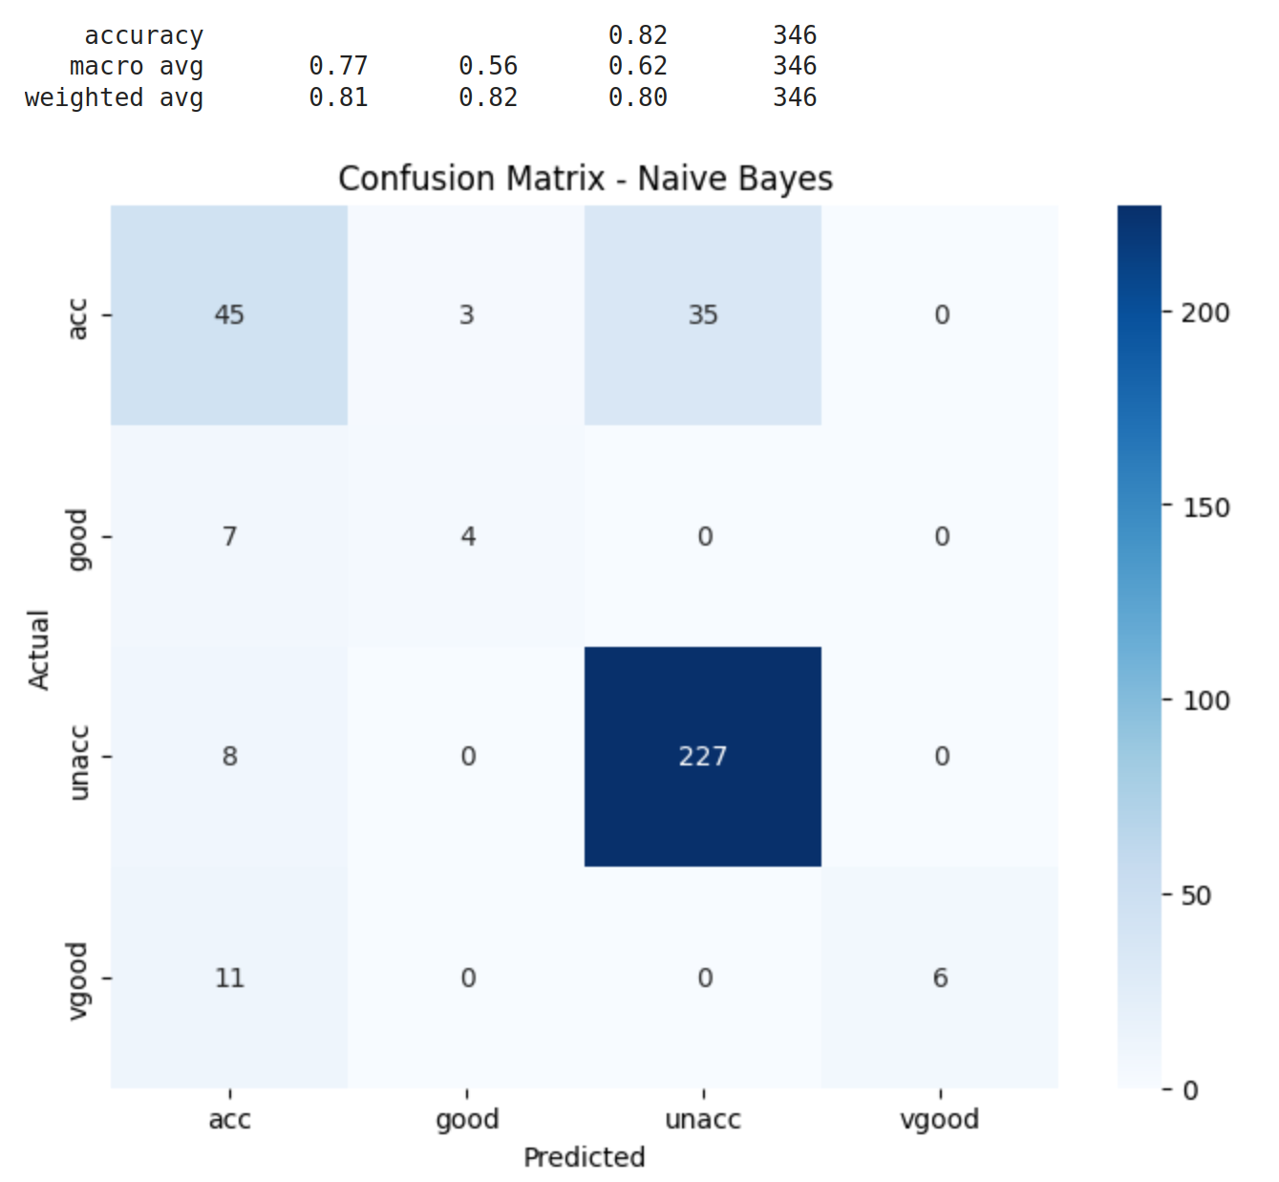
6. Results: Car Dataset (cont. )
K-NN: 94% baseline accuracy, Polynomial Features worsened accuracy slightly.
Categorical Naive Bayes: 82% accuracy.
Decision Tree: Best model, 98% accuracy.

Slide 10
7. Conclusion
Preprocessing and tuning greatly improved model performance.
Random Forest excelled for wine dataset; Decision Tree excelled for car evaluation.
Importance of choosing the right model and preprocessing based on dataset.

